Slide 1
Shooting for the Moon Opportunities and Challenges for Cislunar Development
Dr. James Vedda Center for Space Policy and Strategy
The Aerospace Corporation
July 9, 2019

Slide 2
Humans to the Moon by 2024
Can we achieve the short-term objective without sacrificing long-term goals?
2019 timeline
March 26: VP Pence announced administration direction to return humans to the Moon by 2024 “by any means necessary”
Jim Bridenstine, April 9: “The first phase is speed… Anything that is a distraction from making that happen we’re getting rid of.”
May 13: Supplemental FY20 request for Artemis program includes $1.6 billion and authority for the NASA Administrator to transfer funds between accounts
May 14 Senate hearing: Administrator Bridenstine pledged that new Artemis funding will come from outside of NASA and he will not cannibalize one part of NASA to feed another
June 13: Administrator Bridenstine told media interviewers that Artemis would cost $20-30 billion in FY20-24 – an average increase of $4-6 billion per year over NASA’s FY19 budget

Slide 3
Seeking long-term strategy for cislunar development
What are the goals and objectives?
Top-level goals: expand human knowledge and resources, improve the economy and quality of life, increase chances for humanity’s survival
Space age benefits contributing to the goals (so far)
Revolutionary science through new tools and vantage points
Safer, richer, more connected society through space applications
Achieved almost entirely using disposable space systems that receive and transmit electromagnetic information
The next plateau
Routine physical manipulation of objects in space (e.g., building, servicing, mining, manufacturing, debris cleanup)
Human habitation in space on a scale significantly beyond anything experienced to date

Slide 4
What missions serve a long-term strategy?
Challenges for NASA and its partners
Enable aggressive cislunar development
Fund and perform early-stage, high-risk research and development
Build or sponsor key infrastructure elements
Become an anchor tenant for promising new space industries and/or facilities
Resolve the two greatest physiological challenges to long-duration spaceflight: microgravity and radiation exposure
Pursue development of rotating variable gravity habitats and determine the minimum gravity level needed to maintain health
Experiment with shielding and medical countermeasures to mitigate radiation exposure
Demonstrate that humans can “live off the land” in space
Maximize reuse of space systems
Learn how to routinely use extraterrestrial material and energy resources
Develop the means for extraterrestrial production of routine supply needs
Take on the planetary defense and survival missions
Outsider threat: Detect, categorize, and track solar system bodies that may pose a collision threat for Earth; develop countermeasures and response plans
Insider threat: Expand the spatial, spectral, and temporal observation of Earth and its atmosphere to detect and report anomalies and identify trends; deliver results that are useful to national and international decision-makers, space operators, and other relevant responders
Transition to a new generation of science missions that include:
Humans and robots working together on planetary surfaces
Deep space robotic probes that are assembled on orbit, allowing more ambitious missions

Slide 5
Future infrastructure elements
To be developed by NASA and its partners
Transportation: Earth-to-orbit/reentry, LEO to higher orbits & Moon, other inter-orbital vehicles, lunar landers
Communications & navigation services, including spectrum management
Space surveillance/traffic management
Space weather forecasting
On-orbit servicing
Human-rated modules in orbit and on planetary bodies (e.g., labs, habitation)
Standardization
Extraction & processing of extraterrestrial resources
Planetary protection (forward & backward contamination)
Energy collection & distribution (e.g., solar & nuclear power, propellant storage)
Manufacturing facilities

Slide 6
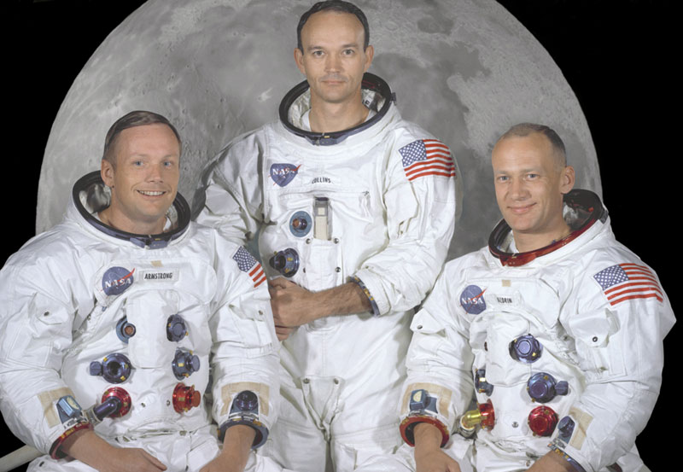
Known unknowns
A sample of questions that still need answers
What modifications to building, resource extraction, and manufacturing techniques are needed in orbital or planetary environments?
What solutions will be employed to mitigate the cost of access to orbit and provide a system of interorbital transportation?
Which orbits and points in cislunar space will prove most useful for various tasks and low-energy transits?
How many people will be routinely needed, and how frequently will they rotate back to Earth?
Will there be geopolitical obstacles to cooperation among cislunar spacefarers? Which spacefaring entities will be friends and allies, and which will be potential adversaries? Will terrestrial conflict prompt decision-makers to consider tactics that disrupt cislunar operations?

Slide 7
Backup

Slide 8
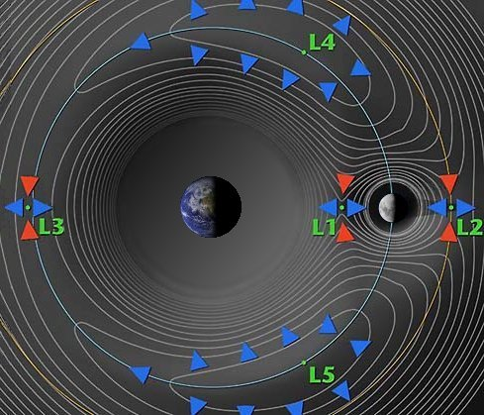
Source: NASA

Slide 9
“The most important reason to go to the moon is because it is the best way to get to Mars… We have to figure out how we live and work on another world using the resources of that world for long periods of time. The moon is the proving ground for that.” – Jim Bridenstine, Politico interview, June 13, 2019

Slide 10
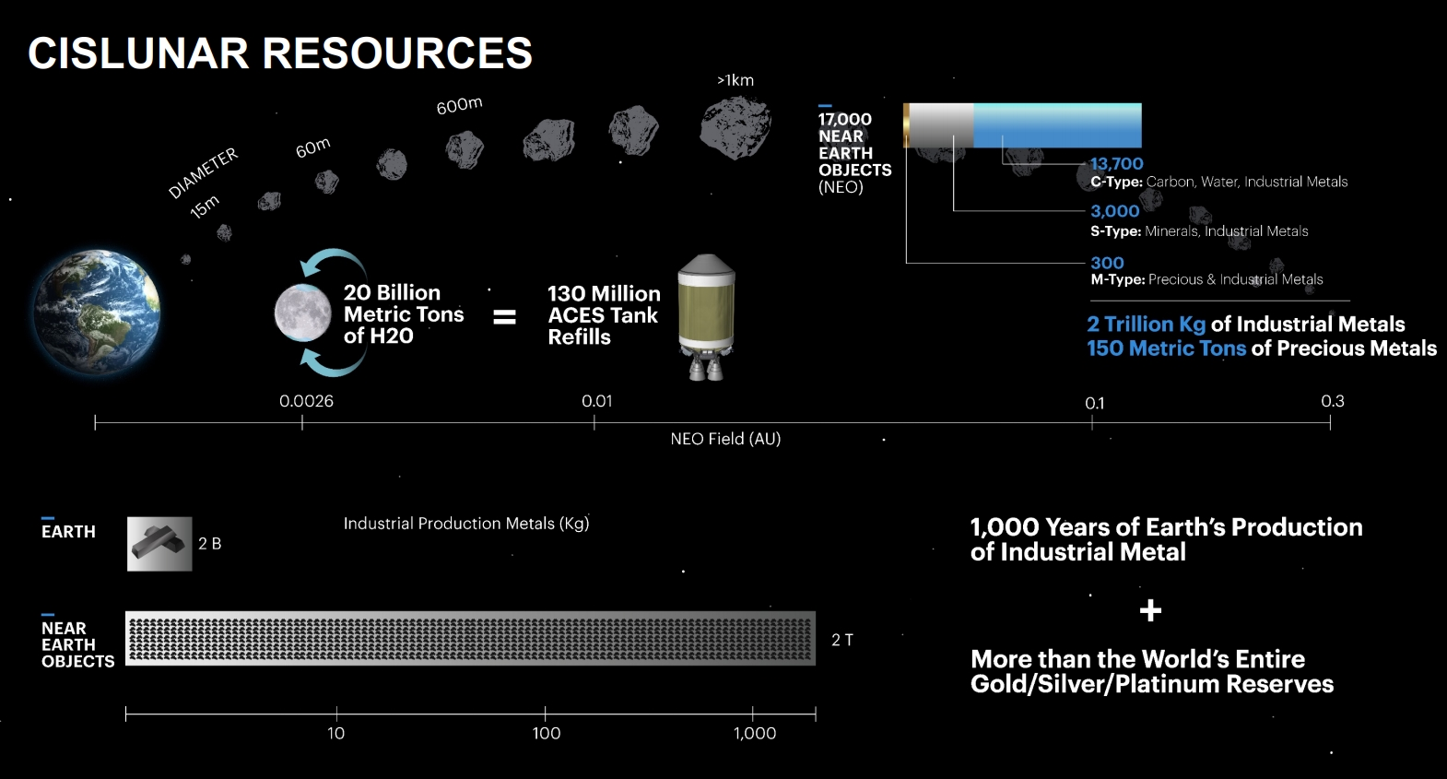
Source: NASASpaceflight.com

Slide 11
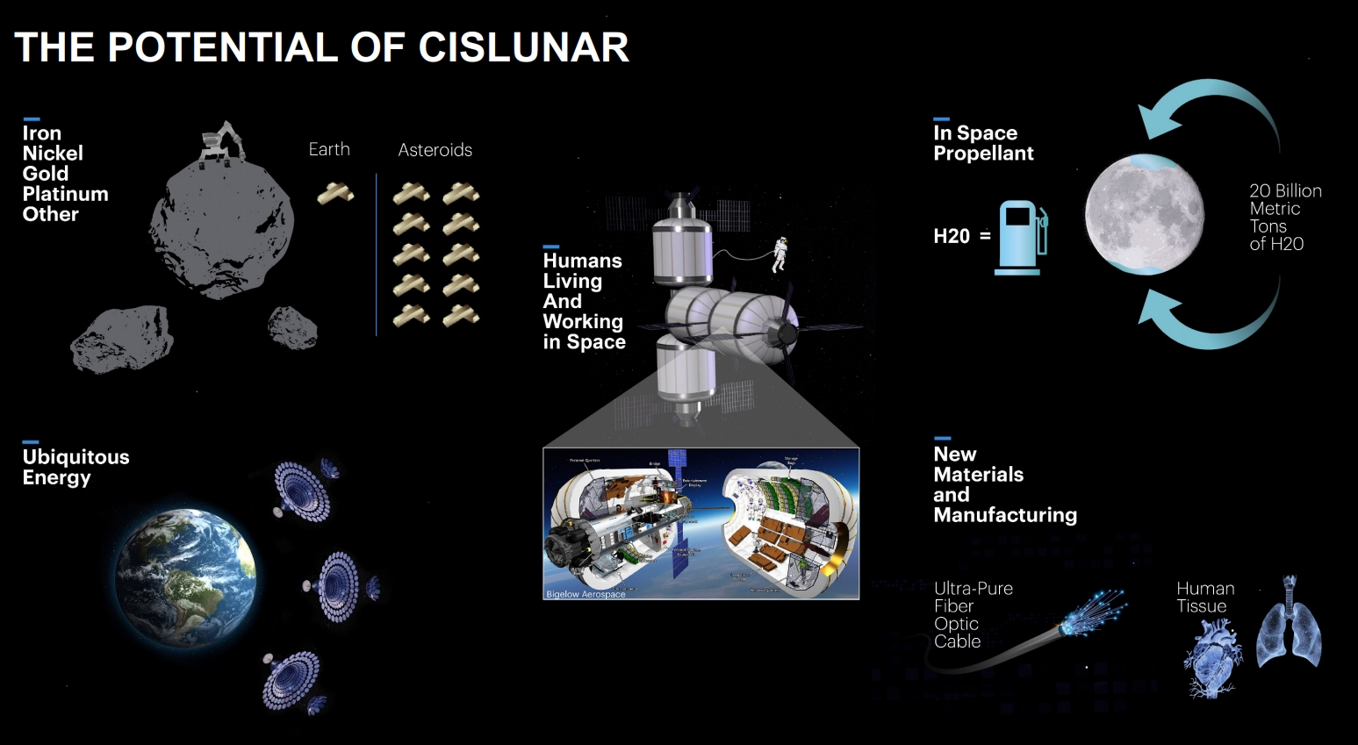
Source: NASASpaceflight.com

