Slide 1
Tardigrades Teacher Slides
Teacher’s Name and Class –
October 2020

Slide 2

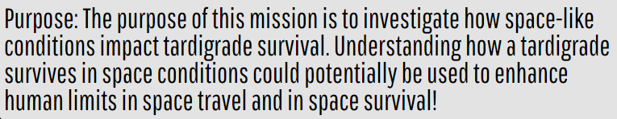
Mission Brief
Notes:
Tips on How to Discuss the Mission Brief
Highlight the purpose of this mission with students.
Students do not know what a tardigrade is at this point. Introduce it as an animal here on Earth that scientists are interested in exploring.

Slide 3
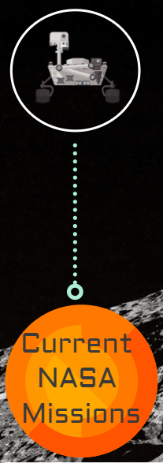
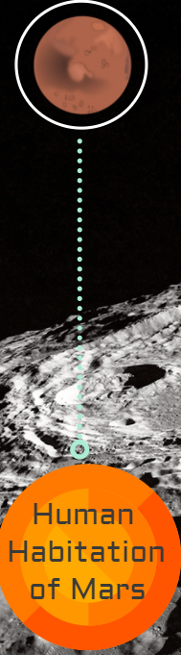
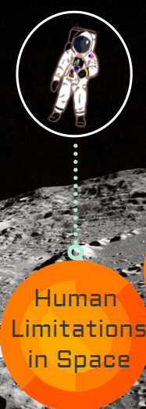
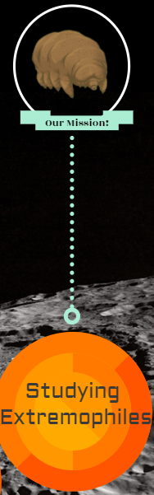
Notes:
Tips on How to Discuss the Mission Brief
The orange circles on the bottom move from the big picture to a more focused lens of the lesson goal. Talk to students about the current Sample Return Mission, future aspirations of human exploration of Mars, and then move into our limitations and need to explore organisms here on Earth for help.

Slide 4
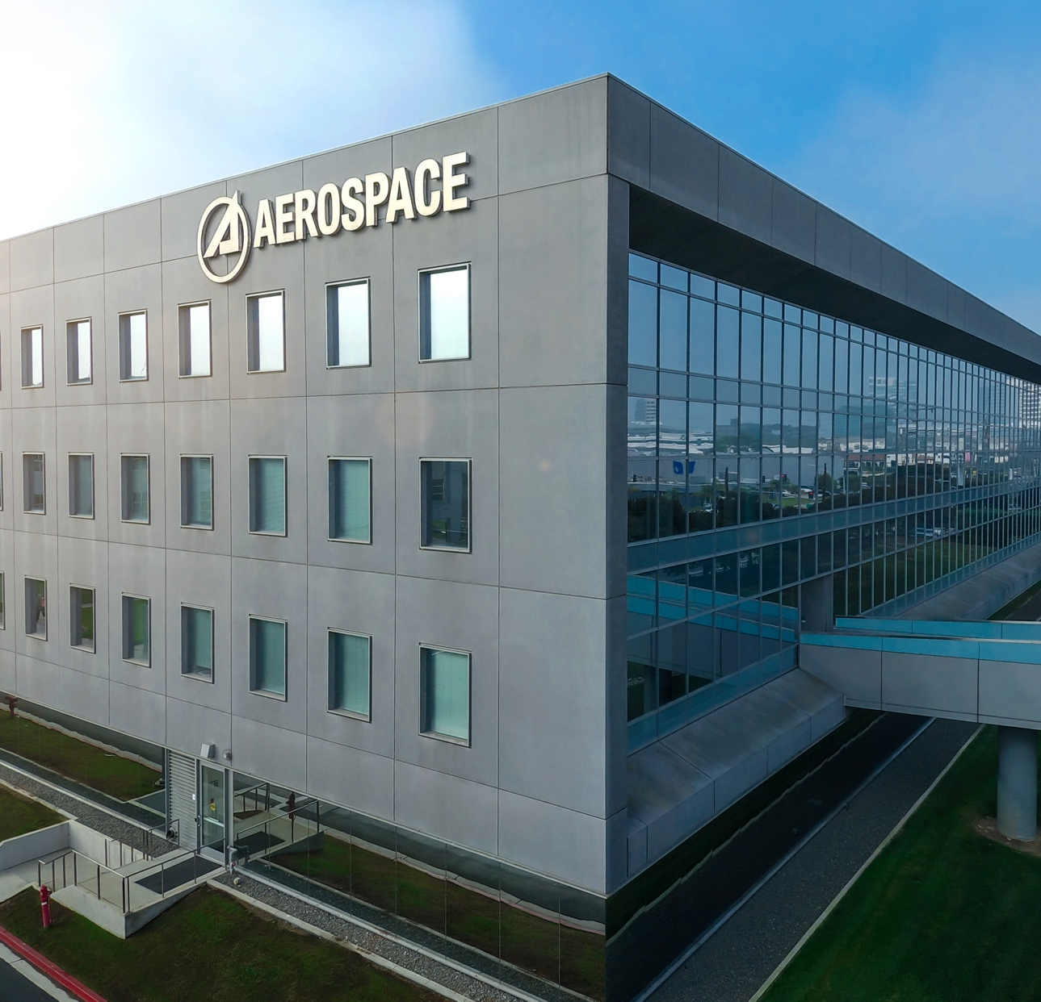
Section A – Mission Brief
What does the Mission Brief suggest about your task to help The Aerospace Corporation?

Slide 5
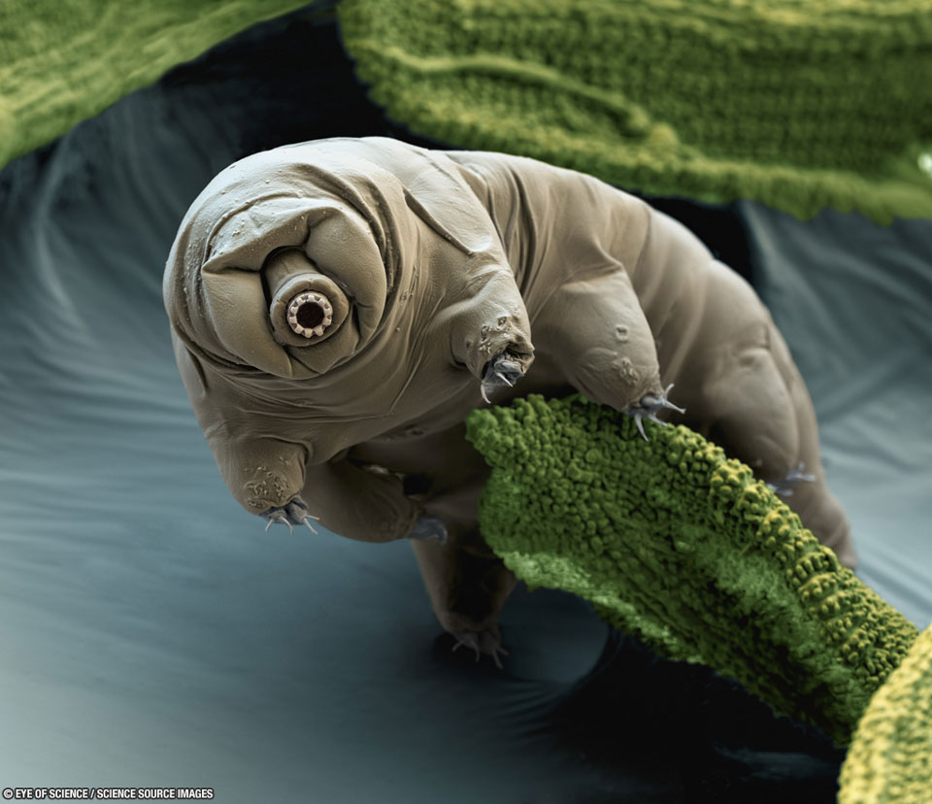
Section B – Tardigrade Introduction
Why do space scientists want to study tardigrades? List what variables they study.
Notes:
image: https://science.nasa.gov/tardigrade-moss

Slide 6
Section C – Vocabulary Development

Slide 7
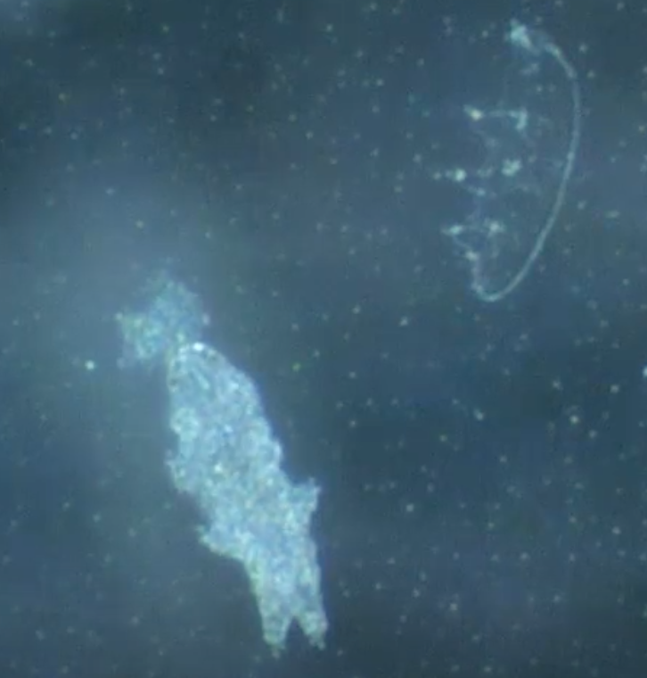
Section D – Tardigrade Lab Exploration
Describe the shape of a tardigrade as seen under the microscope.
Describe how a tardigrade moves. (This means you will need to search the field for a tardigrade that is in motion to observe).
If you can find one that is eating, describe how a tardigrade eats. Include the movements it takes to eat and how the body changes with the addition of food.

Slide 8
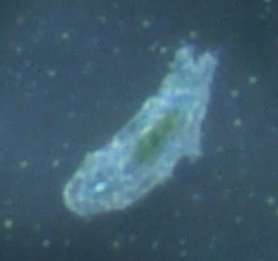
Section E – Why Tardigrades?
Answer after watching the video:
What variables do scientists study when looking at tardigrades? Explain what you think each variable means.
What information do scientists hope to gain from studying tardigrades? Explain how that information will help space travel and exploration.
Answer after the class discussion:
Which variable is most interesting to you in tardigrade studies? Explain what about it interests you.
Why do we study tardigrades?

Slide 9
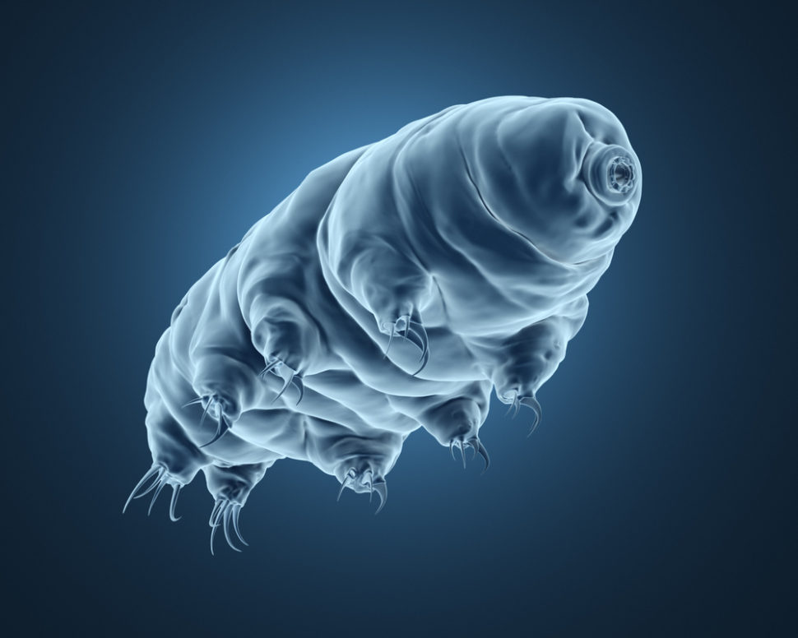
Variables for Experimental Design
Temperature
Vacuum
Lack of Water (dehydration)
Radiation - modeling as a class
Notes:
image: https://www.google.com/url?sa=i&url=https%3A%2F%2Fedgy.app%2Ftardigrades-crash-landed-on-the-moon-and-probably-survived&psig=AOvVaw3n3L2sitDJoJzC_O8v56R2&ust=1602802254673000&source=images&cd=vfe&ved=0CAIQjRxqFwoTCPj47OqVtewCFQAAAAAdAAAAABAp

Slide 10
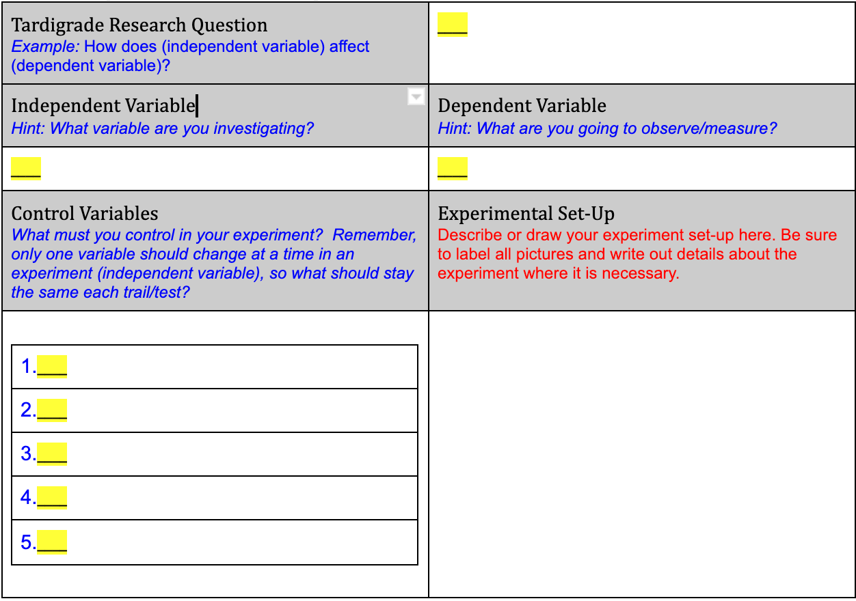
Section F – Modeling the Experimental Design Process

Slide 11
Section G – Student-Led Experimental Design

Slide 12
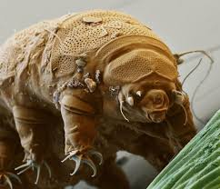
Section H - Modeling Results Analysis
What is the independent variable (x-axis) on the graph?
What is the dependent variable (y-axis) on the graph?
What pattern do you see in the graph?
Do tardigrades survive after being introduced to your variable? Yes or No.
How does survivorship change when your variable is introduced to the tardigrades?
Notes:
image: https://www.google.com/url?sa=i&url=https%3A%2F%2Fwww.smithsonianmag.com%2Fsmart-news%2Fcrashed-spacecraft-might-have-put-water-bears-moon-180972840%2F&psig=AOvVaw3n3L2sitDJoJzC_O8v56R2&ust=1602802254673000&source=images&cd=vfe&ved=0CAIQjRxqFwoTCPj47OqVtewCFQAAAAAdAAAAABAP

Slide 13
Section I - Student-Led Results Analysis
What is the independent variable (x-axis) on the graph?
What is the dependent variable (y-axis) on the graph?
What pattern do you see in the graph?
Do tardigrades survive after being introduced to your variable? Yes or No.
How does survivorship change when your variable is introduced to the tardigrades?
Notes:
image: https://www.google.com/url?sa=i&url=https%3A%2F%2Fwww.smithsonianmag.com%2Fsmart-news%2Fcrashed-spacecraft-might-have-put-water-bears-moon-180972840%2F&psig=AOvVaw3n3L2sitDJoJzC_O8v56R2&ust=1602802254673000&source=images&cd=vfe&ved=0CAIQjRxqFwoTCPj47OqVtewCFQAAAAAdAAAAABAP

Slide 14
Section J – Modeling Claim-Evidence-Reasoning
What pattern did you notice when looking at your data?
Make a claim about how tardigrades responded to your variable compared to humans.
What was the most important observation you made that supports your claim? (This must just be what you noticed. Do not explain what it means or why it supports your claim yet, just say what you saw).
What is another observation you made that supports your claim? (This must just be what you noticed. Do not explain what it means or why it supports your claim yet, just say what you saw).
What is one last observation you made that supports your claim? (This must just be what you noticed. Do not explain what it means or why it supports your claim yet, just say what you saw).
Explain how what you observed (from section D) supports your claim. What does your data mean about how tardigrades will behave in space-like environments? Use words like resiliency/resilient.

Slide 15
Section J – Writing Claim-Evidence-Reasoning
What pattern did you notice when looking at your data?
Make a claim about how tardigrades responded to your variable compared to humans.
What was the most important observation you made that supports your claim? (This must just be what you noticed. Do not explain what it means or why it supports your claim yet, just say what you saw).
What is another observation you made that supports your claim? (This must just be what you noticed. Do not explain what it means or why it supports your claim yet, just say what you saw).
What is one last observation you made that supports your claim? (This must just be what you noticed. Do not explain what it means or why it supports your claim yet, just say what you saw).
Explain how what you observed (from section D) supports your claim. What does your data mean about how tardigrades will behave in space-like environments? Use words like resiliency/resilient.

Slide 16
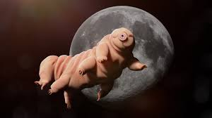
Section L – Claim-Evidence-Reasoning Share Out
Write your team’s Claim-Evidence-Reasoning
Notes:
image: https://www.google.com/url?sa=i&url=https%3A%2F%2Fwww.popularmechanics.com%2Fspace%2Fa11137%2Ftardigrades-water-bears%2F&psig=AOvVaw3n3L2sitDJoJzC_O8v56R2&ust=1602802254673000&source=images&cd=vfe&ved=0CAIQjRxqFwoTCPj47OqVtewCFQAAAAAdAAAAABAJ

Slide 17
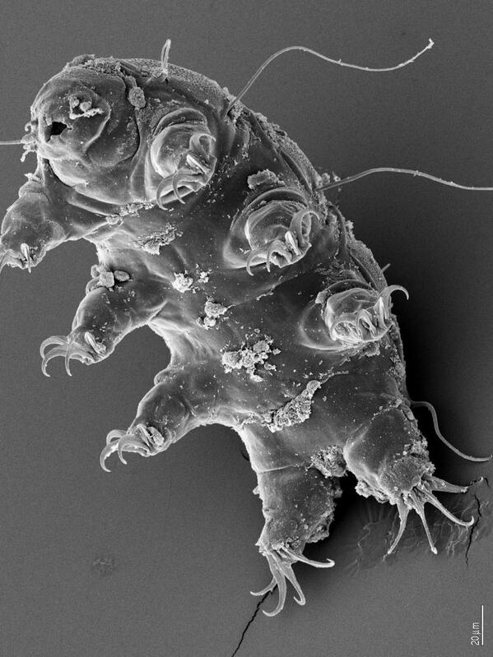
Section M – Reflection Questions
Now that you understand how tardigrades respond to space-like conditions, why are tardigrades necessary to study when it comes to humans traveling in space?
What else are you interested in studying about tardigrades? What other variables could be explored? Explain what you would hope to learn from these variables.
Notes:
image: https://www.google.com/url?sa=i&url=https%3A%2F%2Ftwitter.com%2Fnasa%2Fstatus%2F455513140520701952&psig=AOvVaw3n3L2sitDJoJzC_O8v56R2&ust=1602802254673000&source=images&cd=vfe&ved=0CAIQjRxqFwoTCPj47OqVtewCFQAAAAAdAAAAABAD

